Slide 1
DATA PROGRAMMING FINAL PROJECT Group No.: 5
TITLE : WEB APPLICATION DASHBOARD FOR COVID-1 9
Team
Anjali - 200507078
Ritij Sharma – 200503507
Tathagat Arya - 200503756
Vaishnavi Rammohan Sheshadri - 200494034
Vatsal Prajapati – 200482541

Slide 2
TEAM DESCRIPTION
A web application was developed based on the Covid-19 dataset using Flask Framework.
TEAM MEMBERS AND TASKS PERFORMED
TATHAGAT ARYA – LEAD DEVELOPER
Developed the application’s working on front end.
VATSAL PRAJAPATI – DATA ANALYST
Acquired the data, built the data models and database using Mongo DB. (BACK END)
VAISHNAVI SHESHADRI and ANJALI – BUSINESS ANALYST
Built the documentation for the final proposal.
RITIJ SHARMA – PROJECT MANAGER
Worked on the deliverable of the project, also worked along with the Business Analyst to build the documentation for final proposal .

Slide 3
INTRODUCTION TO THE PROJECT
The following project has been developed to create a Web Application based on a Covid-19 Dataset. The data has been scrapped from the Data source and stored in our Cloud Database which is Mongo DB. A dashboard has been created using Flask which exactly demonstrates the Visualizations of Covid-19 related data.

Slide 4
Flask - Python
Classified as a microframework, Flask is a small and lightweight Python web framework that provides useful tools and features that make creating web applications in Python easier.
Flask uses the Jinja template engine to dynamically build HTML pages using familiar Python concepts such as variables, loops, lists, and so on.
Flask is also extensible and doesn’t force a particular directory structure or require complicated boilerplate code before getting started.

Slide 5
Advantages of using Flask
There is a built-in development server and a fast debugger provided.
Lightweight
Secure cookies are supported.
Templating using Jinja2.
Request dispatching using REST.
Support for unit testing is built-in

Slide 6
MONGO DB
MongoDB is a source-available cross-platform document-oriented database program. Classified as a NoSQL database program, MongoDB uses JSON-like documents with optional schemas. MongoDB is developed by MongoDB Inc. and licensed under the Server Side Public License.

Slide 7
Advantages of MongoDB
Easy to store structured or unstructured data.
Supporting hybrid and multi-cloud applications
Scalability and Transactionality
Integrating large amounts of diverse data
Supporting agile development and collaboration
Describing complex data structures that evolve

Slide 8
Demonstration
API > Python script > stored to MongoDB > Visualizations/Dashboard > Hosted on a website

Slide 9
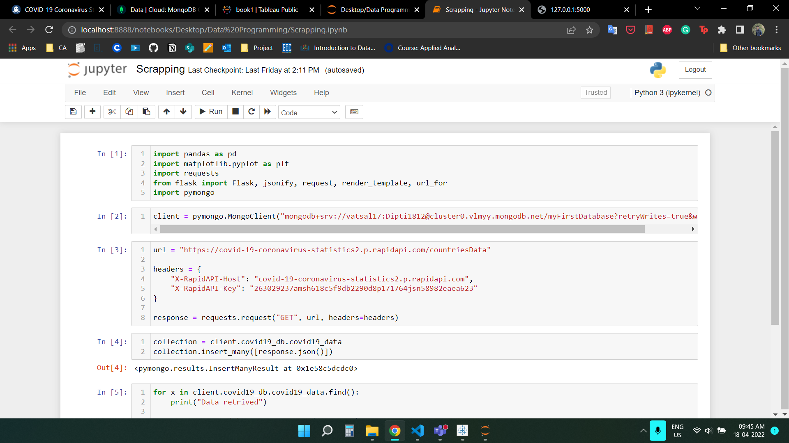
Python Script

Slide 10
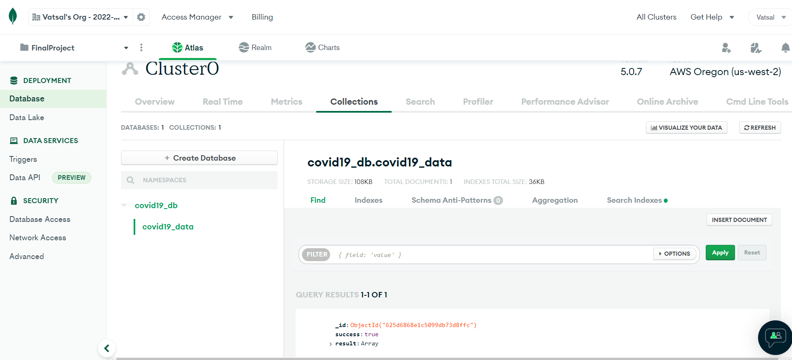
Mongo DB

Slide 11
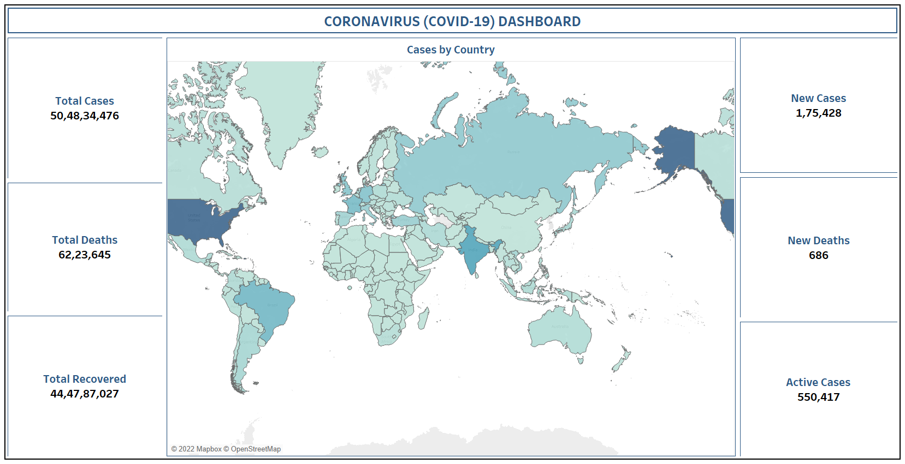
COVID-19 DASHBOARD
https://rapidapi.com/collectapi/api/covid-19-coronavirus-statistics2/

Slide 12
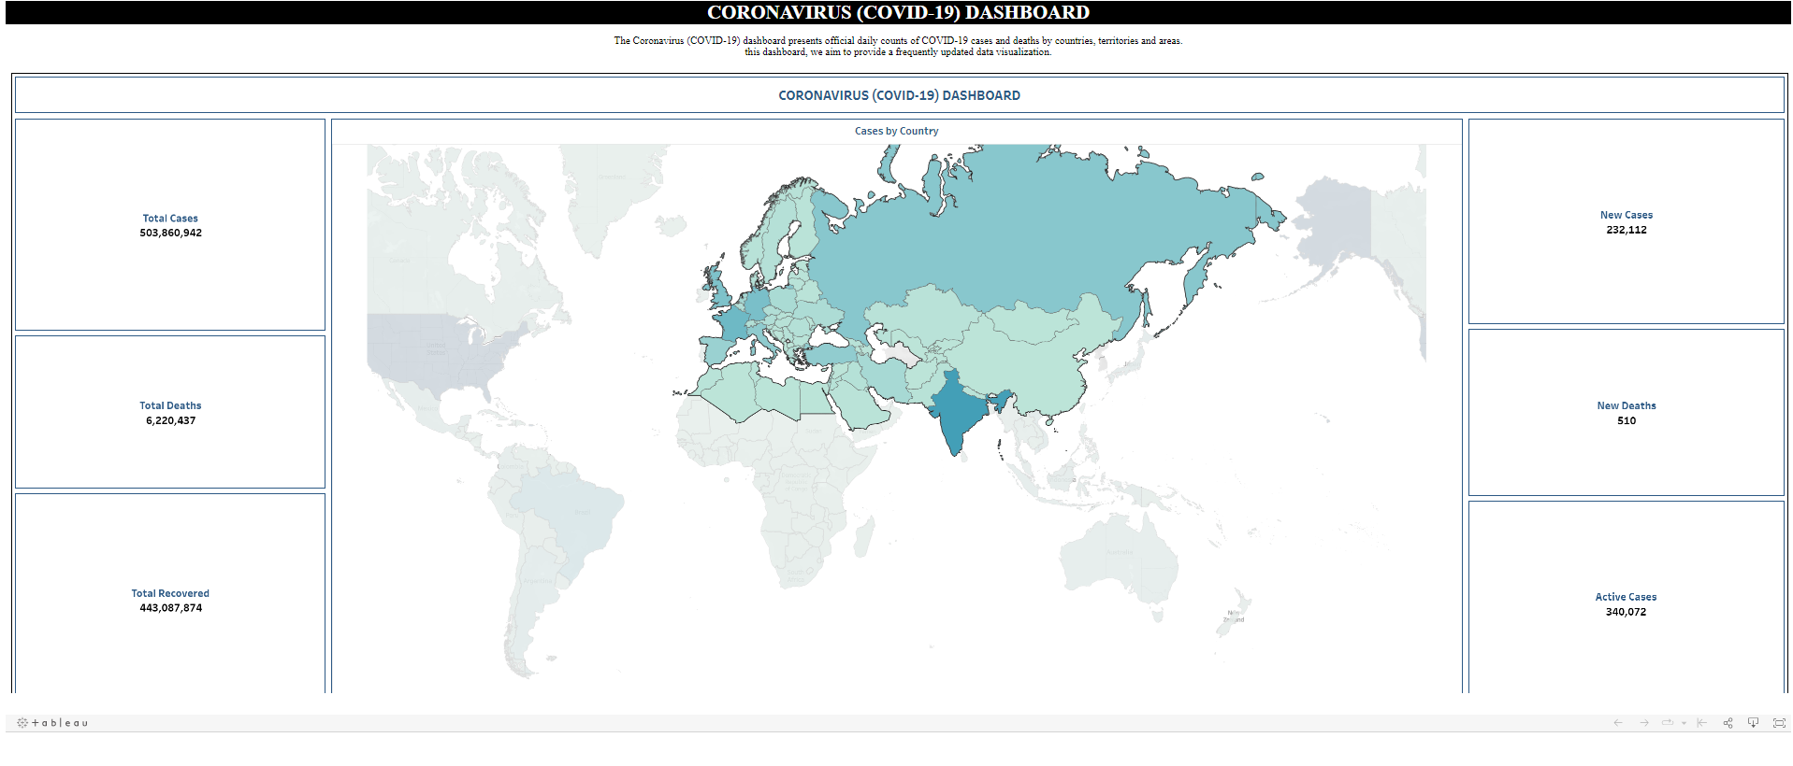
Website

Slide 13
Sources
Youtube - https://www.youtube.com/watch?v=Qr4QMBUPxWo
Tutorials point
Wikipedia

